Slide 1

Propensity Model Case Study Predicting at risk customers
Sanjeev Kumar Gautam
Sanjeev.ga@outlook.com

Slide 2

Introduction
Objective: Building a Propensity Model for Predicting At-Risk Customers and unveiling Patterns and Strategies for Customer Retention

Slide 3
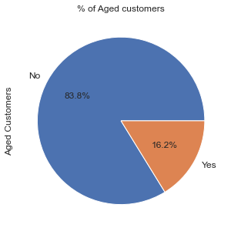
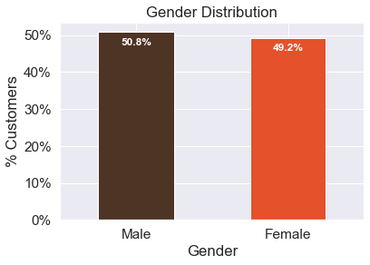
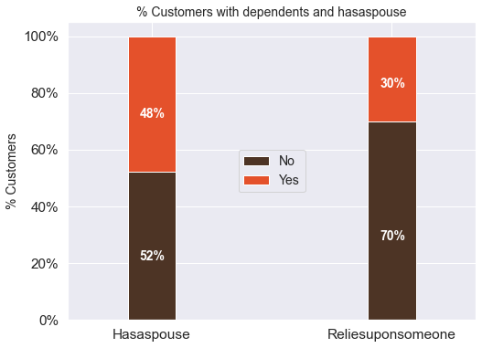
Exploratory Data Analysis (EDA):

Slide 4
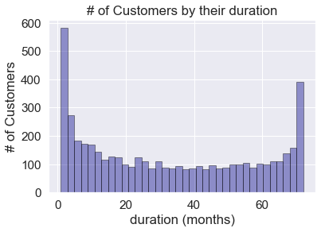
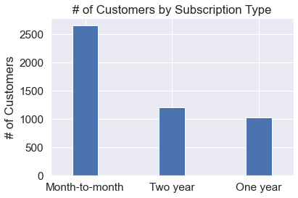
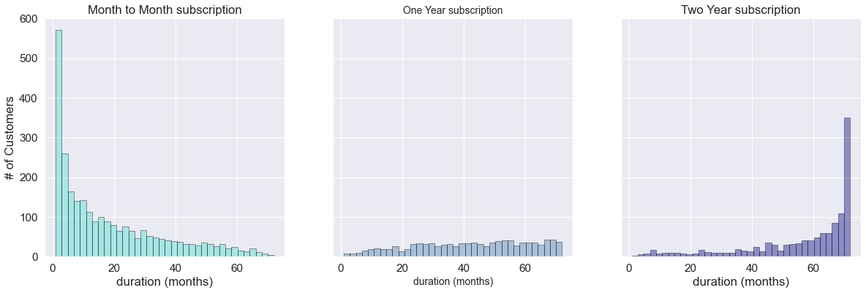
EDA Cont.

Slide 5
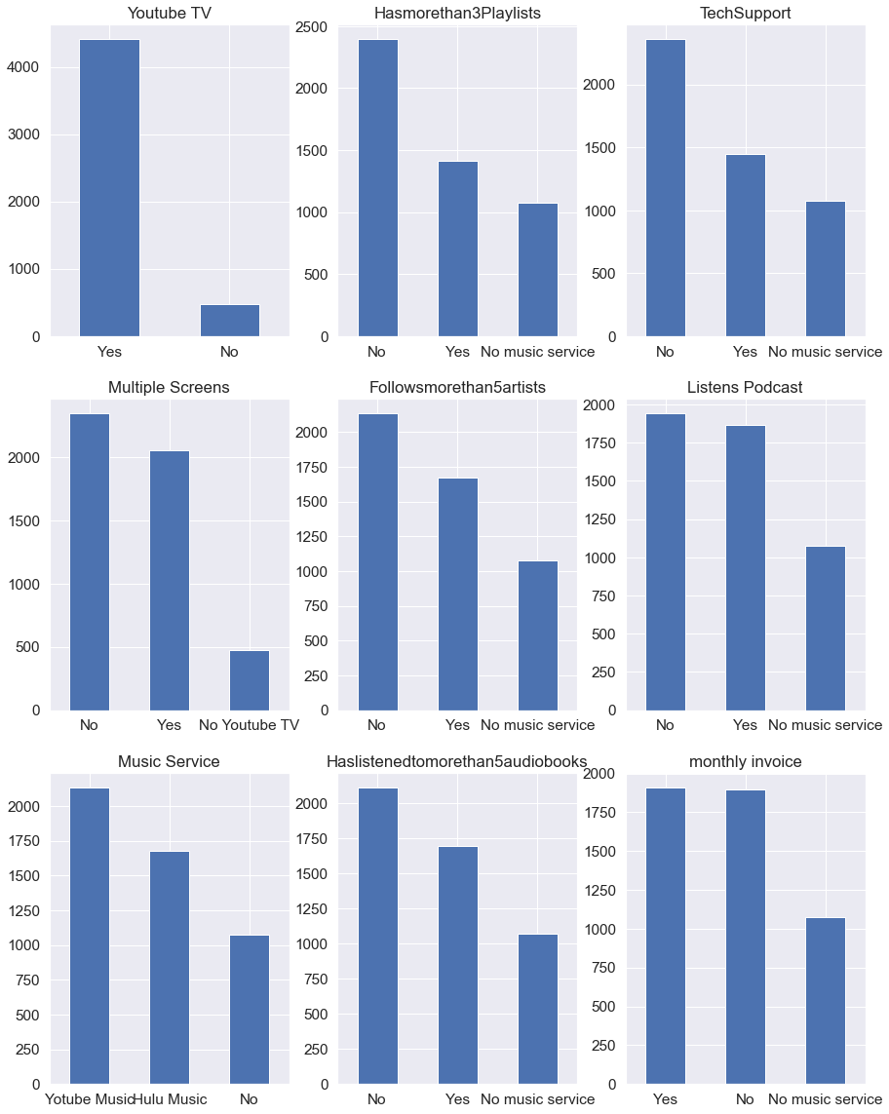
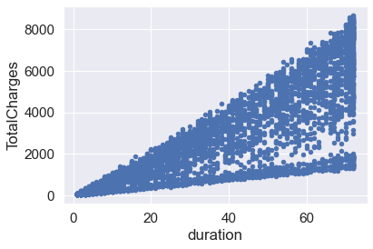
Bar plot of different services used by customers and relation between total charge and duration

Slide 6
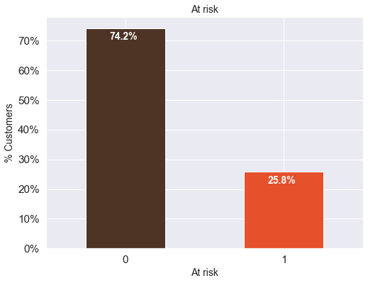
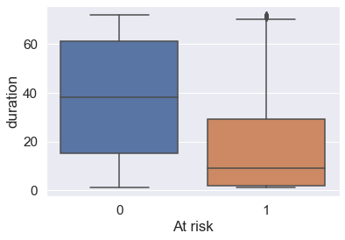
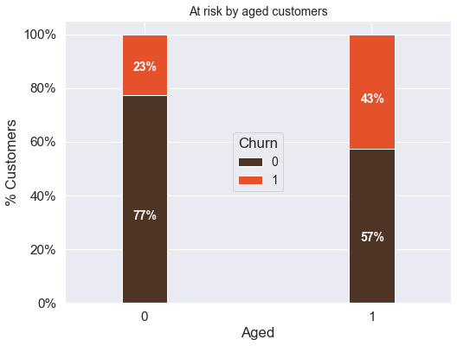
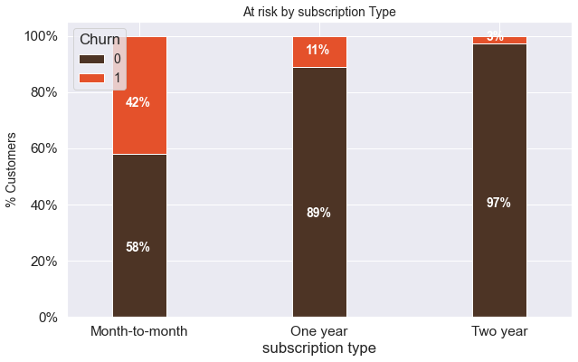
At Risk ANalysis

Slide 7
Key Insights from EDA
'Month-to-month' subscription, absence of tech support, and payments through 'paycheck' show positive correlations with 'At Risk,' indicating higher propensity likelihood.
Longer duration, One Year/Two Years subscriptions, higher 'Total Charges,' 'CC' and 'online banking' payment methods exhibit negative correlations with being 'At Risk,' suggesting lower propensity likelihood.
Only 16.2% of customers fall into the 'aged' category, indicating a predominantly young customer base.
About 50% have spouses, while 30% are dependent, revealing varied family structures.
Exploring customers with both spouses and dependencies provides insights into overlapping dependencies.
Majority of customers have a one-month subscription, indicating a continuous influx of new customers.
Long-term customers are observed with subscriptions exceeding 70 months, influenced by specific subscription types.
A majority opt for 'Month-to-month,' while 'Two-year' and 'One-year' subscriptions are nearly equal.
Longer contract durations are associated with lower churn, aligning with the correlation findings.
'Month-to-month' contracts exhibit a high churn rate, emphasizing their influence on customer retention.
Senior citizens show almost double the churn rate compared to younger demographics, indicating significant age-based differences in churn behavior.

Slide 8
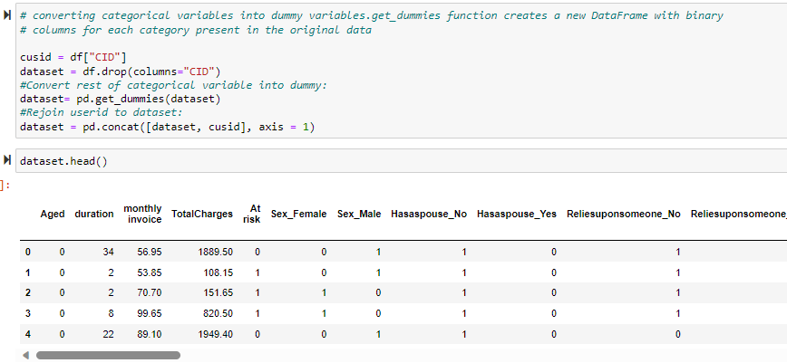
Encode Categorical data
One-hot Encoding using get_dummies method in panadas

Slide 9
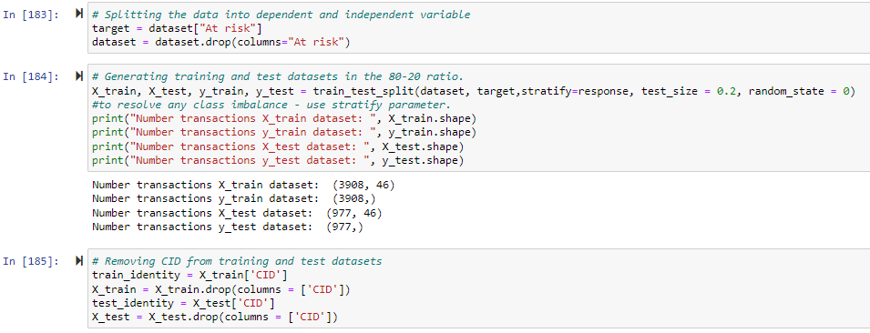
Generate training and test datasets
Generating training and test datasets in the 80-20 ratio

Slide 10
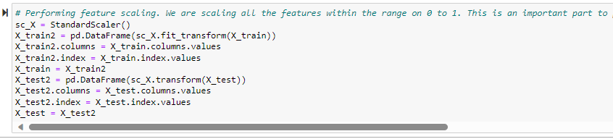
Feature Scaling
Scaling all the features within the range on 0 to 1.

Slide 11
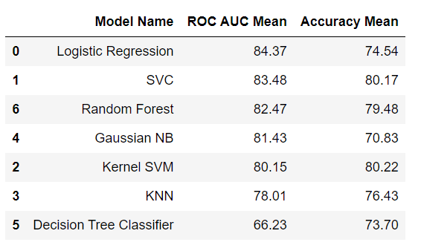
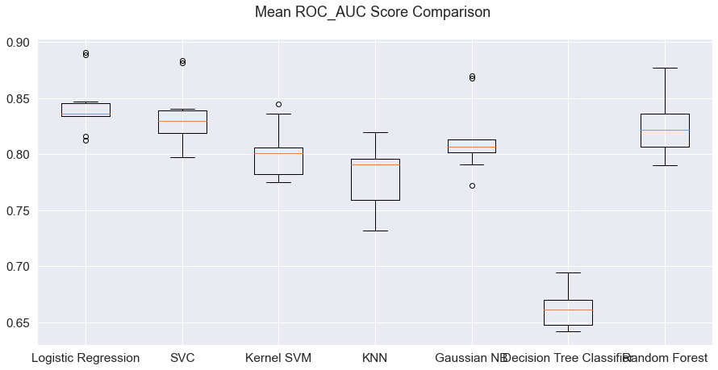
Model Selection
Comparison of baseline models
Logistic Regression and Support Vector Classifier (SVC) have outperformed the other five models for the selected dataset

Slide 12
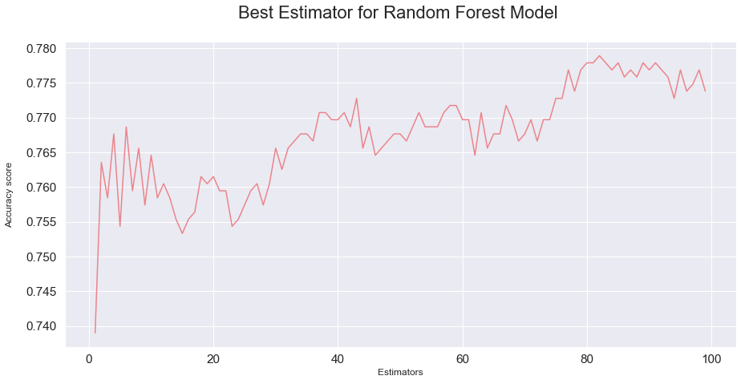
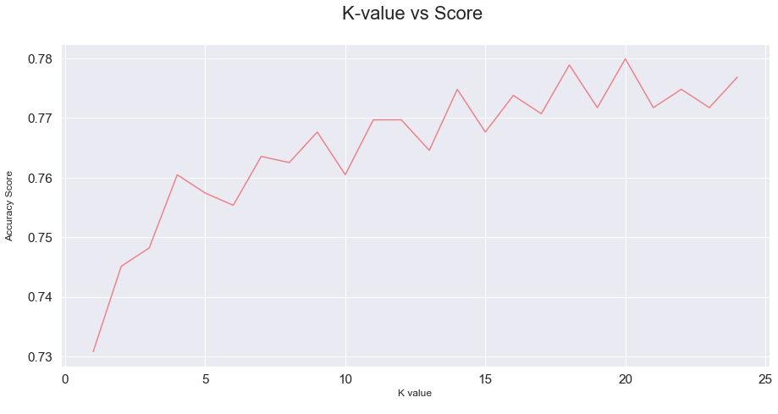
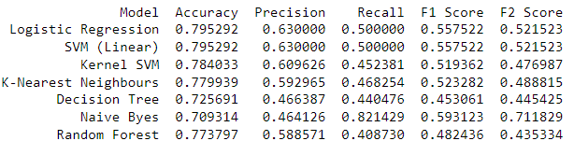
Fine Tuning models
Finding optimal number of K neighbors for KNN Model(20)
Finding optimal number of estimator for Random Forest Model (82)
Still logistic regression emerges as the optimal model for the given dataset

Slide 13
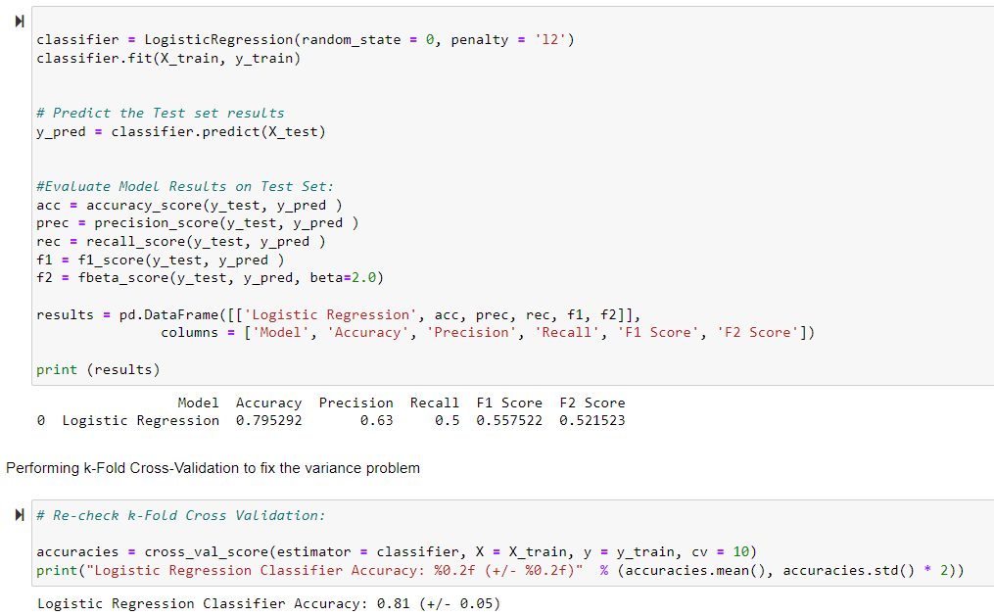
Train Logistic Regression(Our Best Model)

Slide 14
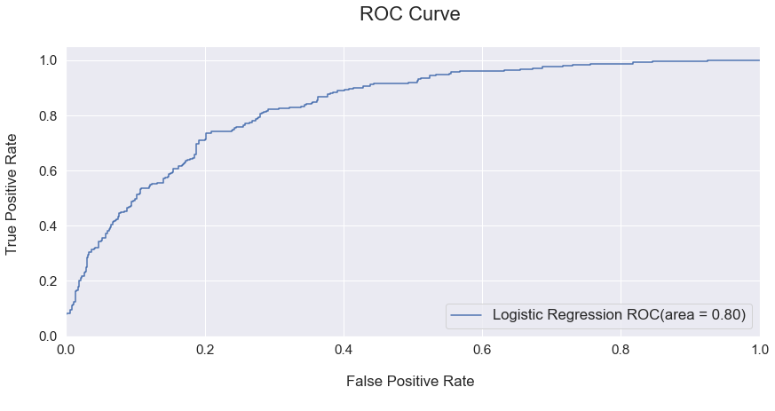
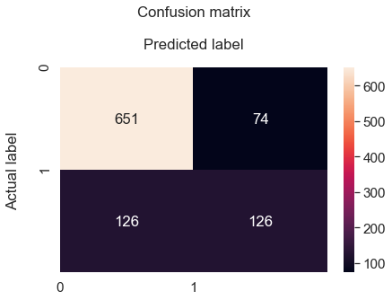
Evaluating Final model

Slide 15
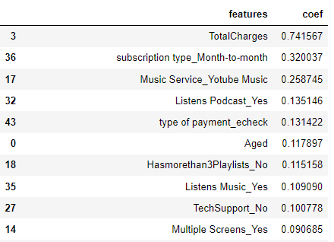
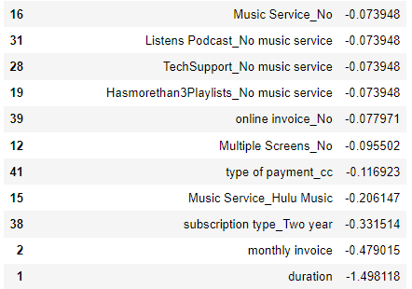
Feature Importance
The logistic regression model predicts a positive correlation between the risk rate and variables such as TotalCharges, subscription type month-to-month, electronic checks as the payment method, and the absence of tech support.
Conversely, the model predicts a negative correlation with the risk rate for customers with longer durations, subscription types of two years or one year, and those using online banking or courier checks as modes of payment.

Slide 16
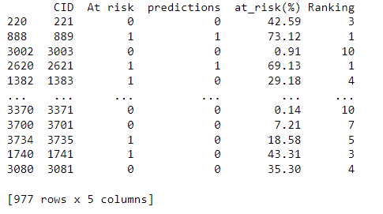
Prediction
Propensity scores add depth to predictive models, offering a percentage-based probability for each ‘CID' rather than a binary outcome (0 or 1).
Propensity scores act as a strategic tool, enabling organizations to mitigate risks by assessing the likelihood of individual responses in situations characterized by unpredictability.

Slide 17
Conclusion
Data Quality Matters: Emphasize the significance of data preprocessing in building a robust predictive model and the critical role of understanding and reshaping variables.
Class Imbalance Awareness: Highlight the identification of class imbalance issues and the importance of addressing them during model evaluation.
Exploring Patterns with EDA: Shared key insights from the exploratory data analysis
Logistic Regression Triumph: Acknowledge Logistic Regression as the optimal model choice, showcasing superior performance in terms ROC AUC score.
Robust Model Evaluation: Discuss the effectiveness of k-fold Cross-Validation in mitigating variance issues and ensuring reliable model performance.
Insights from Feature Importance: Showcase key indicators of customers at risk revealed through feature importance analysis, guiding future business strategies.
Continuous Improvement: Emphasize the iterative nature of the modeling process, encouraging ongoing refinement and adaptation to evolving business dynamics.

Slide 18

Question?

Slide 19


